Slide 1
Working with Fractions
Level Two
Notes:
This PowerPoint matches the information in the How To Fractions Guide for level two. The examples and explanations are the same but the Try it Out questions are different allowing additional individual practise.

Slide 2
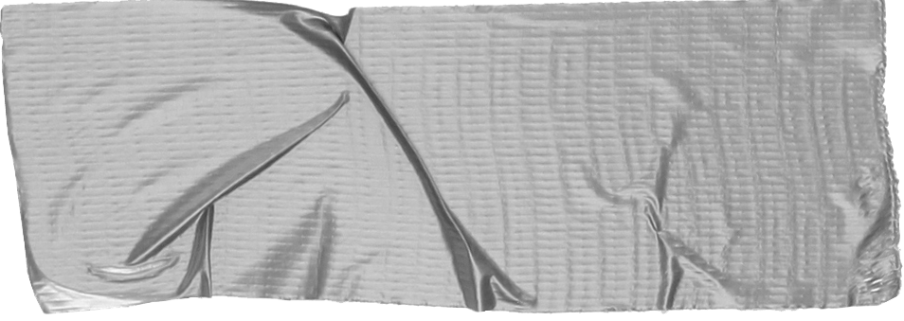
Aims
Define fractions clearly
Find fraction parts

Slide 3
Objectives
Define fractions clearly
To identify the numerator and denominator
To explain the concept of a fraction

Slide 4
What is a fraction?
Fractions can be described as parts out of a total or parts out of a whole amount
$\frac{Parts }{Total }$ or $\frac{Parts }{Whole }$

Slide 5
The whole or total amount is always the bottom of the fraction. (Denominator)
The part you are interested in is the top of the fraction. (Numerator)
The line represents a division.

Slide 6
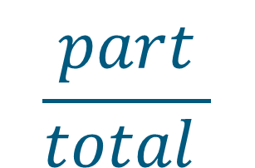
numerator
$$\frac{part}{total }$$
divide
denominator

Slide 7
Learning Check
Can you define fractions clearly?
Can you identify the numerator and denominator?
Can you explain the concept of a fraction?

Slide 8
Objectives
Find Fraction Parts
To identify the correct process to use
Use multiplication and division skills to find fraction parts
To complete word problems about fraction parts

Slide 9

To find fraction parts
$÷$ by the bottom of the fraction
x by the top of the fraction

Slide 10
Examples
$\frac{1}{4}$of 60
First, divide 60 by 4
60 $÷$ 4 = 15
Next, multiply your answer by the top of the fraction
15 x 1 = 15
$\frac{1}{4}$of 60 = 15

Slide 11
C$an you find \frac{1}{5}$ of 85.25?
First, divide 85.25 by 5
85.25 $÷$ 5 = 17.05
Next, multiply your answer by the top of the fraction
17.05 x 1 = 17.05
$\frac{1}{5}$ of 85.25 = 17.05

Slide 12
C$an you find\frac{2}{3} \text{of}\text{ 45}$?
First, divide 45 by 3
45 $÷$ 3 = 15
Next, multiply your answer by the top of the fraction
15 x 2 = 30
$\frac{2}{3} \text{of}\text{ 45}$= 30

Slide 13
What would happen…
If you multiplied by the top number first, then divided by the bottom?
Try it out by finding $\frac{2}{3} \text{of}\text{ 45. }$

Slide 14
You can choose whichever method works best for you

Slide 15
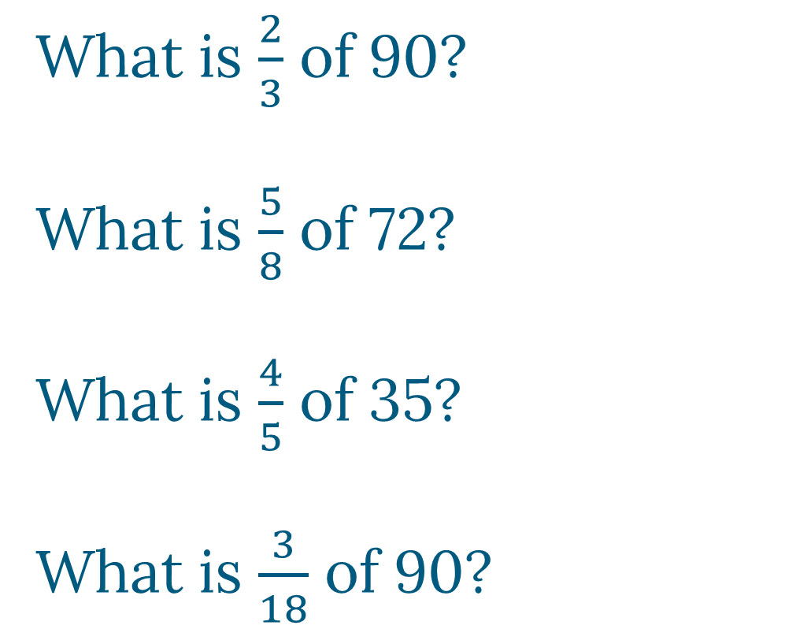
Try it Out
What is $\frac{2}{3}$ of 90?
What is $\frac{5}{8}$ of 72?
What is $\frac{4}{5}$ of 35?
What is $\frac{3}{18}$ of 90?
60
45
28
15

Slide 16
Top Tip
Make sure you know what the total or whole amount is before you start your calculation

Slide 17
Try it Out
Try the word problems on the next few slides in your group

Slide 18
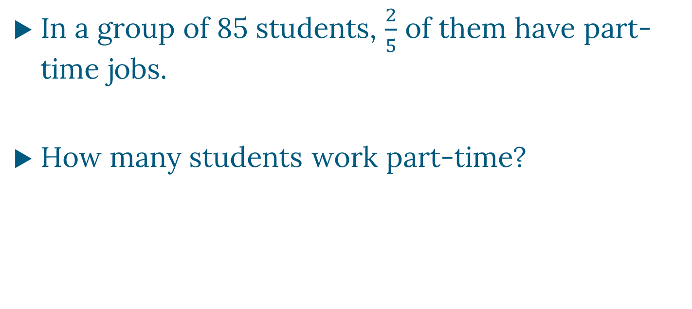
Question 1
In a group of 85 students, $\frac{2}{5}$ of them have part-time jobs.
How many students work part-time?

Slide 19
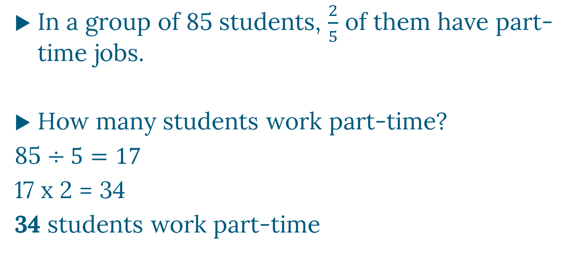
ANSWER
In a group of 85 students, $\frac{2}{5}$ of them have part-time jobs.
How many students work part-time?
85 $÷5=17$
17 x 2 = 34
34 students work part-time

Slide 20
Question 2
In a sport club, there is a choice of either football or basketball on a Tuesday evening. Out of the 78 members, one third play football and the rest play basketball. How many play basketball?

Slide 21
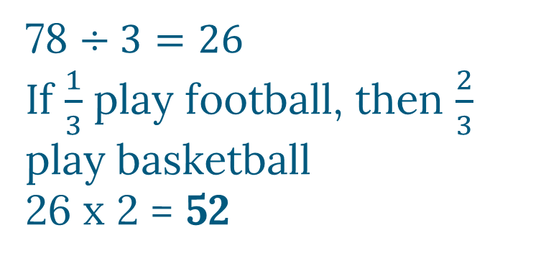
ANSWER
In a sport club, there is a choice of either football or basketball on a Tuesday evening. Out of the 78 members, one third play football and the rest play basketball. How many play basketball?
78 $÷3=26$ OR
26 x 1 = 26
78 – 26 = 52
78 $÷3=26$
If $\frac{1}{3}$ play football, then $\frac{2}{3}$ play basketball
26 x 2 = 52

Slide 22
Question 3
It is recommended that you drink at least 2000 litres of water per day. Abid drunk $\frac{3}{4}$ of that amount while he was at work.
How much water has he drunk?

Slide 23
ANSWER
It is recommended that you drink at least 2000 millilitres of water per day. Abid drunk $\frac{3}{4}$ of that amount while he was at work.
How much water has he drunk?
2000 $÷4=500$
500 x 3 = 1500
1500 litres

Slide 24
Learning Check
Can you find fraction parts?
Can you identify the correct process to use?
Can you use multiplication and division skills to find fraction parts?
Can you complete word problems about fraction parts?

