Slide 1
Temperature Activity

Slide 2
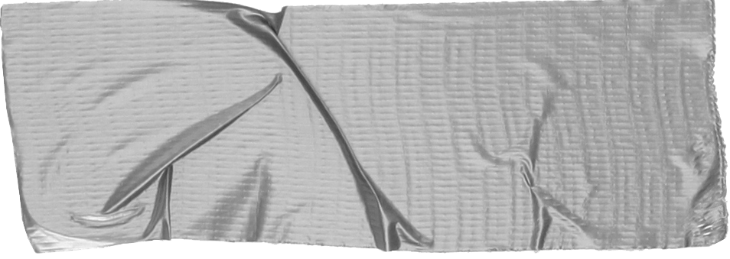
Aims
To identify the formula for converting between Celsius and Fahrenheit
To use the formula to convert between them
To complete a table of converted values
To draw a graph based on the values
To use the graph to convert values

Slide 3
To convert between Fahrenheit and Celsius use the following formula.

Slide 4
•$C=(F−32)\frac{5}{9}$

Slide 5
Task 1
Write the formula in slope/intercept form

Slide 6
Task 2
Create a table like the one on the next page
Select ten cards each from the pile
Add them in the appropriate column in your table
Use the formula to complete the table using your values
Task 3
Draw a graph of your values
Remember to label the graph
Choose a different set of five Celsius cards
Create a new table with three columns and six rows (see example)
Fill in your values and use your graph to convert them to Fahrenheit
Now use the formula to convert the values to check how accurate your graph is
Repeat with five Fahrenheit cards and a new table (see example)

Slide 7
•
Celsius | Fahrenheit

Slide 8
•
Celsius | Fahrenheit from graph | Fahrenheit from formula

Slide 9
•
Fahrenheit | Celsius from graph | Celsius from formula

Slide 10
Recap
To identify the formula for converting between Celsius and Fahrenheit
To use the formula to convert between them
To complete a table of converted values
To draw a graph based on the values
To use the graph to convert values

